Slide 1
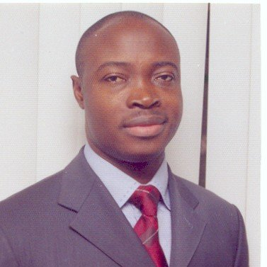
MR. BIMBO ABIOYE CEO FINTRAK SOFTWARE NIGERIA
Fintrak Software is a global ICT organization providing technology and business solutions to mainly commercial banks, mortgage banks and other financial institutions across Africa. Our core mission is to support businesses with technologies and intellectual strength required to enable them surpass their stakeholders' expectations, through strategic alliances.
The company is managed by 5 Executive Directors and 3 Non-Executive Directors with diverse background and competencies across banking, finance, audit, consulting and software development. The company has a workforce of over 70 staff including over 50 software engineers.
We have successfully implemented over 100 technology solutions for various enterprises engaged in Commercial Banking, Mortgage Banking, Insurance and Manufacturing across: Nigeria, Benin, Togo, Cote D'Ivorie, Gambia, Sierra Leone, Ghana, Senegal, Rwanda, Congo, Zambia and more in progress from our business offices in Nigeria, Ghana, Gambia and Kenya.
At FinTrak Software, we understand our customers' business needs to sustain competitive advantage, profitability are able to support our clients to technologically adapt to ever changing economic policies, regulatory requirements and social dynamism.

